Slide 1
STEEL STRUCTURES
Welding connection:

Slide 2
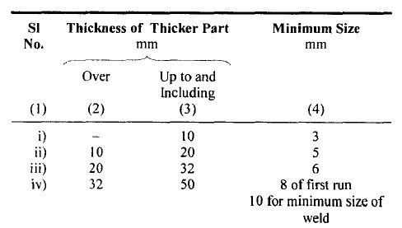
Welding Connection Criteria
Minimum Size of fillet weld

Slide 3
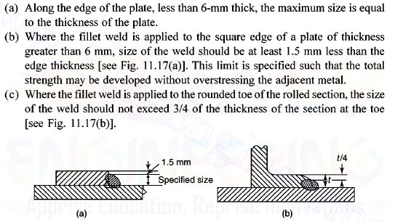
Maximum Size of fillet weld

Slide 4
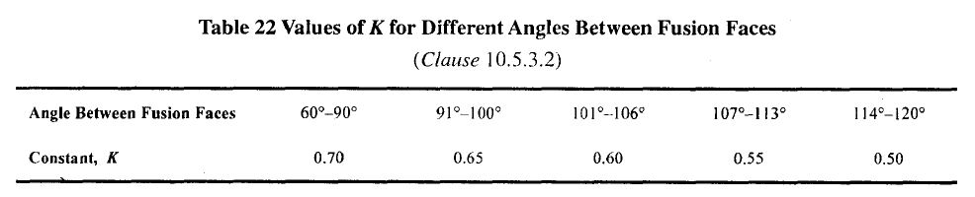
K value as per IS 800: 2007
Based on the angle between two faces:
The effective throat thickness is given as –
t = K x S

Slide 5
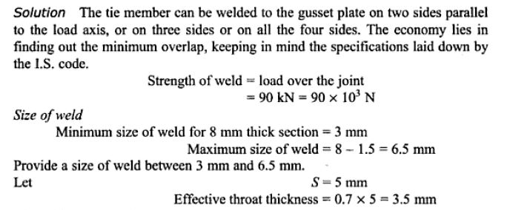
Welded Connection
Question :
A tie member 75 mm x 8 mm is to transmit a load of 90 KN. Design the fillet weld and calculate the necessary overlap. (Allowable stress of weld= 108 N/mm²)

Slide 6
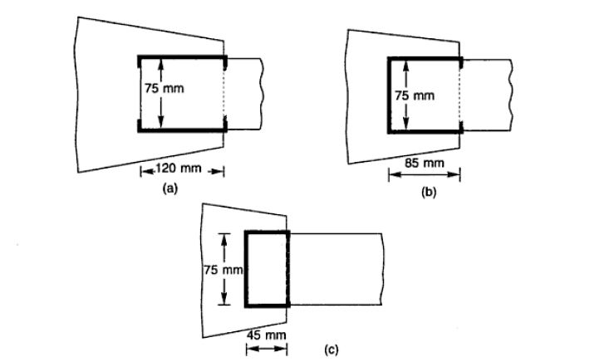
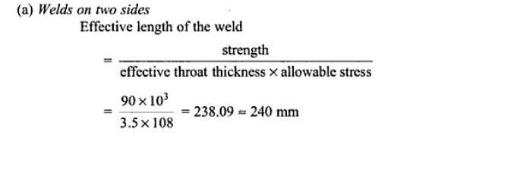
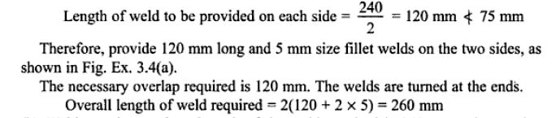

Slide 7
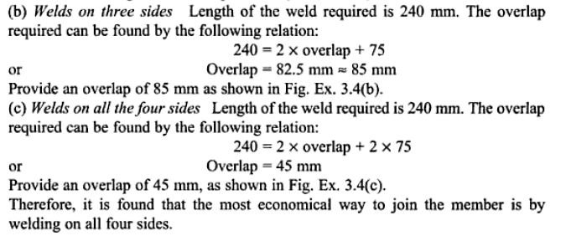

Slide 8
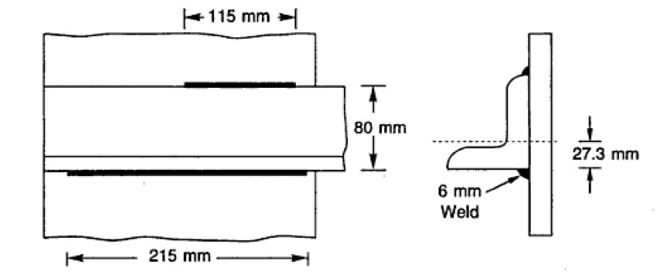
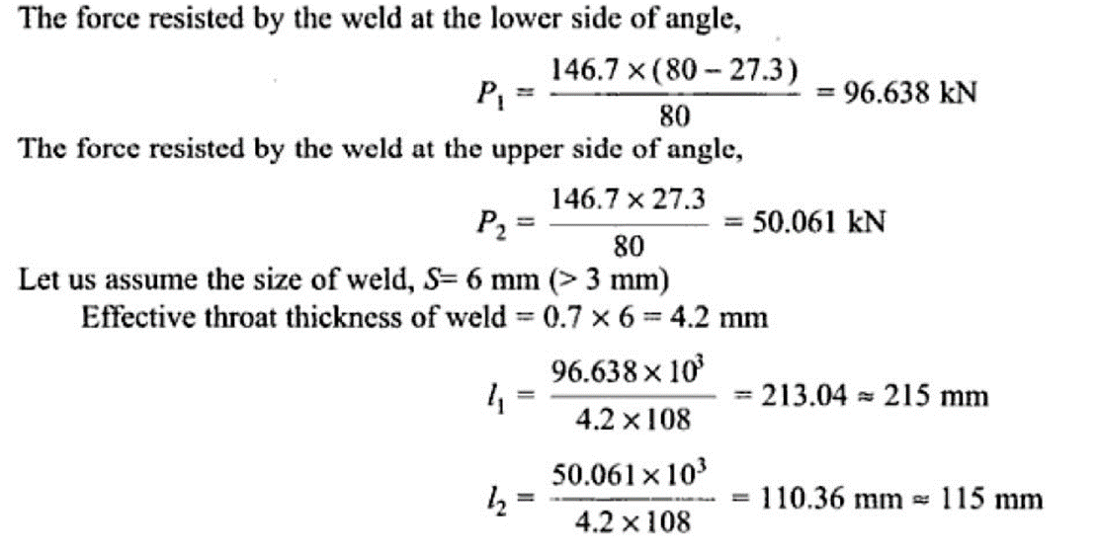

Slide 9
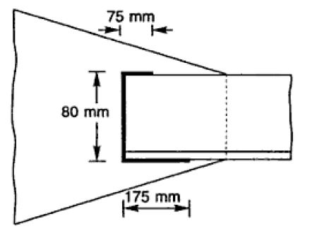
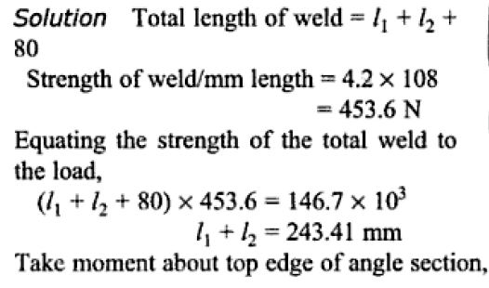
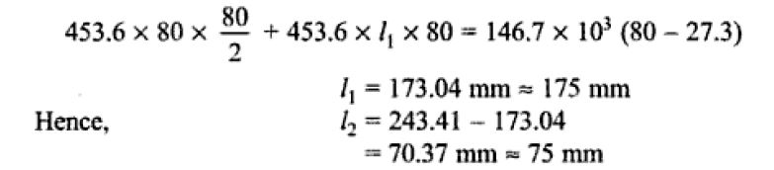
If welding is done on the three sides :

Slide 10
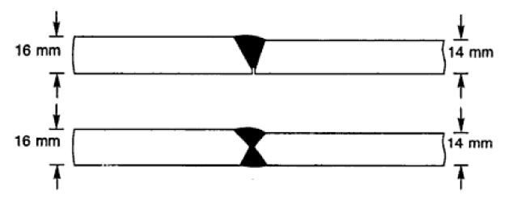
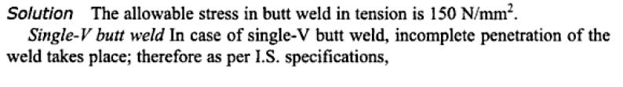
Question : Two plates of thickness 16 mm and 14 mm are to be jointed by a butt weld, as shown in figure. The joint is subjected to a tensile force of 280 KN. Due to some reasons the effective length of the weld that could be provided was 175 mm only. Check the safety of the joint if :
Single-V butt weld is provided.
Double-V butt weld is provided.

Slide 11
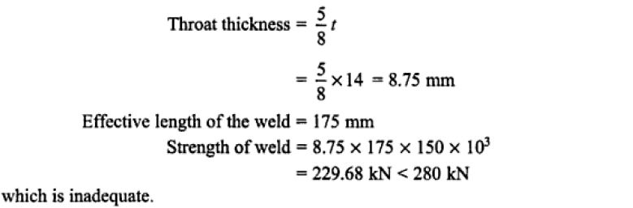
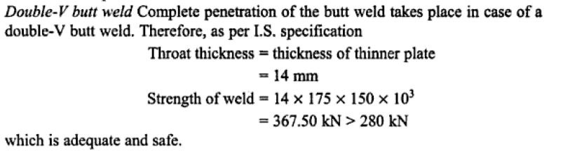

Slide 12
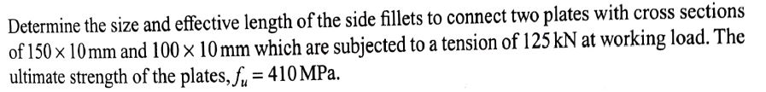
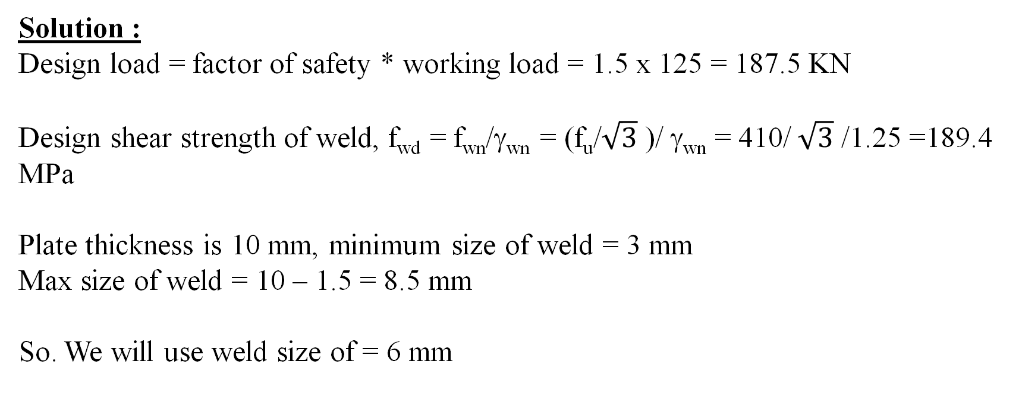
Welded Connection
Question :
Solution :
Design load = factor of safety * working load = 1.5 x 125 = 187.5 KN
Design shear strength of weld, f_{wd} = f_{wn}/γ_{wn} = (f_{u}/$\sqrt{3}$ )/ γ_{wn} = 410/ $\sqrt{3}$ /1.25 =189.4 MPa
Plate thickness is 10 mm, minimum size of weld = 3 mm
Max size of weld = 10 – 1.5 = 8.5 mm
So. We will use weld size of = 6 mm

Slide 13
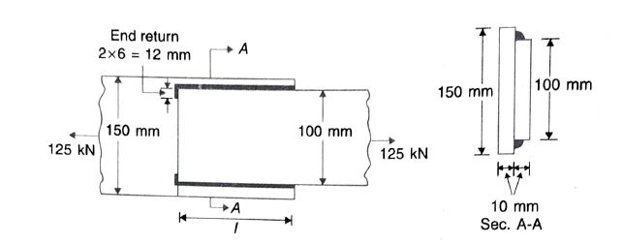
Let l be the effective length of each welds.
V_{wd} = 2 x (0.7 x 6 x l) x f_{wd}
L = 117.8 mm

Slide 14

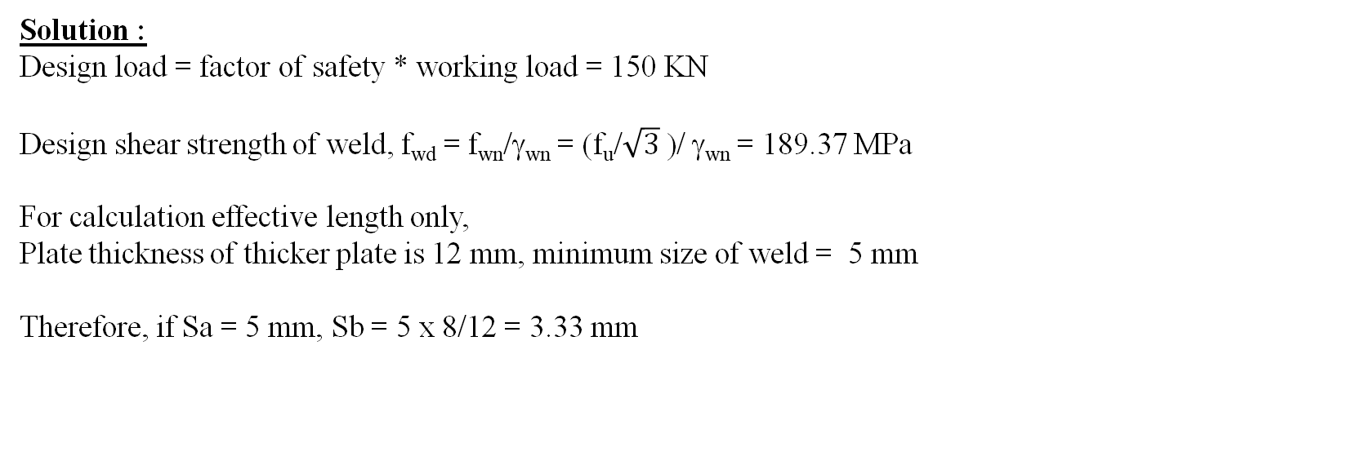
Question :
Solution :
Design load = factor of safety * working load = 150 KN
Design shear strength of weld, f_{wd} = f_{wn}/γ_{wn} = (f_{u}/$\sqrt{3}$ )/ γ_{wn} = 189.37 MPa
For calculation effective length only,
Plate thickness of thicker plate is 12 mm, minimum size of weld = 5 mm
Therefore, if Sa = 5 mm, Sb = 5 x 8/12 = 3.33 mm

Slide 15
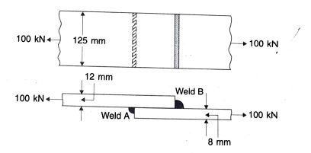
Design shear forces.
V_{wdA} = (Effective length of weld x 0.7 Sa) x f_{wd}
= l x 0.7 x 5 x 189.4
V_{wdB} = l x 0.7 x 3.33 x 189.4
Total = l x 0.7 x 8.33 x 189.4 =150 x 10^3
L = 135.82 mm
Not possible.
Provide l = 125 mm
Therefore calculate Sa + Sb
150 x 10^3 = 125 x 0.7 x (Sa + Sb) x 189.4
Sa + Sb = 9.05 mm
But Sa/Sb = 8/12
Therefore, Sa = 5.45 mm
Sb = 3.6 mm

Slide 16

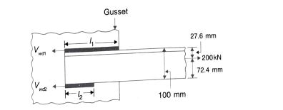
Question :
Solution:
fwd = fwn/factor of safety of weld = 410/ 3^0.5/ 1.25 = 189.37 Mpa
for angle, Cz = Cy = 27.6 mm
Let l1 be the effective length on back of the angle
Let l2 be the effective length on toe of the angle
Let Vwd1 be the design shear force in the weld of effective length l1
And Vwd1 be the design shear force in the weld of effective length l2
Size of the weld should be <= 3/4 * 8 = 6 mm
Let size of the weld be 6 mm
Therefore, Vwdl1 = 0.7 x s x l1 x fwd = 0.7*6*l1*189.37 = 795.354 l1
Vwdl2 = 0.7 x s x l2 x fwd = 0.7*6*l2*189.37 = 795.354 l2

Slide 17
Equilibrium equation,
Vwdl1 + Vwdl2 = 200 x 1000
795.35 (l1 +l2) = 200 x 1000
l1+l2 = 200 x 1000/ 795.35
l1 + l2 = 251.47
Taking moment about a point on the line of action of Vwd1,
Vwd2 x 100 = 200 x 10^3 x 27.6
Vwd2 = 55.2 KN
L2 = 69.40 mm
L1 = 182 mm

